Slide 1








The Bulletin™
Team Pinpoint

Slide 2

Introduction
The Bulletin is a local social media app
designed from the ground up to allow
users to freely express themselves.
The goal is to facilitate spontaneous
local collaboration by allowing users to
contribute events and discussion within
a local area using location services.

Slide 3

Why aren’t we all famous?

Slide 4

Why is Magnus Carlsen so good at chess?

Slide 5

Why do we procrastinate?

Slide 6


Mission Statement
Our team’s vision is to bring communities closer together; to bring it back to a time of forums and local gossip of the old internet.

Slide 7
Team Introduction
Andy Hoang
  ^{Developer}
Citlally Vasquez
  UI/UX Designer and Web developer
Darrel Dennis
  ^{QA Specialist}
Max Ju
  ^{Developer}
Troy Waters
  Cybersecurity and Database Management
Wai Soltow
  ^{Developer}

Slide 8


Ok… but what does it actually do?
Core features:
  Attaching “post” to real, localized areas for other nearby users to read and reply to.
  Live chat to facilitate real-time communication in areas where post may not be the most streamlined option.

Slide 9

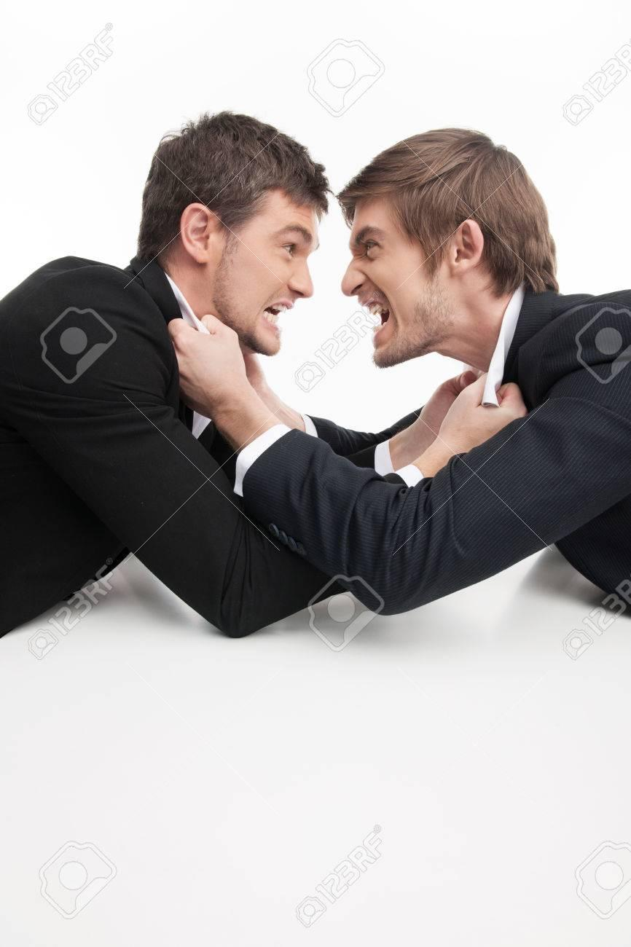

With a little imagination… THAT SOUNDS LIKE A DISASTER!
In our quest to figure out how to develop these tools… we come across an immediate issue: how they’re used.
Automated moderation is our top priority once servers are deployable
Generalizing Locations : Yes, we want to streamline local communication, but not dox ourselves!

Slide 10


So who’s our target audience?
The nature of this project gives us a wide range of potential users: People new to the area, local for discovering communities with similar hobbies, and finding events you didn’t know exist!
Local Arcade meet up? Sure!
Town Hall Events? I didn’t know they had those, I’m down!

Slide 11

Where can The Bulletin be used?
The Bulletin can be used worldwide, by anyone with a smart device and an internet connection!
However, we will prioritize on developing a core user base in the United States due to an English-speaking audience and the fact that no good social community app exists!*
*See next slide

Slide 12


Our Competitors
Pros:
Focused on local neighborhood groups
Has built-in tools to mail invites and give certain messages/posts urgency
Cons:
Private groups require constant moderation
Full of people nagging about their neighbors and nothing else
Pros:
Massive user-base
Has built-in tools for mailing lists, scheduling posts/events, livestreams, etc.
Cons:
Filled to the brims with advertisements
Privacy concerns due to its parent company, Meta

Slide 13





Entrepreneurial Context - Value Proposition
FARMERS MARKET
In 3 days.
491A SLIDES
Happening now!
Location based feeds ensure users are never too far to points of interest (POIs).
Timed user generated POIs will help share and discuss current or upcoming events.
  Store sales
  Public events
  Swap meets
  Conventions
Notes:
Users can effortlessly find local POIs (points of interest) and chat live with those nearby.
Users can ensure they are talking to people in their community and people too far to realistically be related
Talk about the opening of local businesses (coffee shops and restaurants)
Talk about going somewhere new and wanting to find what is going on

Slide 14

Entrepreneurial Context - Monetization Strategy
We have a few ways we plan to monetize the app, such as:
Advertisements from both local and big businesses
In-app purchases for cosmetics for your profile
Optional monthly subscription to remove advertisements (and more!)

Slide 15


So what does this all mean?
The Bulletin will be an interactive online forum for locals of all ages to have fun, interact, and engage in the community!
Won’t be like those other boring neighborhood apps, will keep users up to date, and will offer in-app cosmetics for personalization
“The streets talk, we listen”
Notes:
Conclusion slide - Citlally

Slide 16
Got any questions?

